Slide 1

Interpolation Search

Slide 2
What is Interpolation Search ?
Interpolation Search is an improved version of Binary Search.
It is used for searching in sorted arrays (just like binary search), but it guesses the position of the key based on value-based probing, not just mid-point.
🎯 Key Idea:
If elements are evenly distributed, the desired value is likely to be near the position calculated by interpolation formula.
Instead of checking the middle, we estimate the probable position using:
🔢 Position Formula :
pos = low + ((key - arr[low]) * (high - low)) / (arr[high] - arr[low])
This estimates where the key might be based on how close it is to the values at low and high.

Slide 3
🧠 Difference from Binary Search:
Binary Search
Always checks middle
Good for any sorted array
Time: O(log n)
Interpolation Search
Estimate position using formula
Best for uniformly distributed sorted array
Time: O(log log n) (best case)

Slide 4
When To Use Interpolation Search ?
Sorted array
Uniform or evenly distributed values
Fast when the key is closer to the start or end

Slide 5
🔁 3. Algorithm (Steps)
Set low = 0 and high = n - 1.
While low <= high and key is within arr[low] and arr[high]:
Calculate pos using the formula.
If arr[pos] == key, return pos (found).
If arr[pos] < key, search right part (low = pos + 1).
If arr[pos] > key, search left part (high = pos - 1).
If not found, return -1.

Slide 6
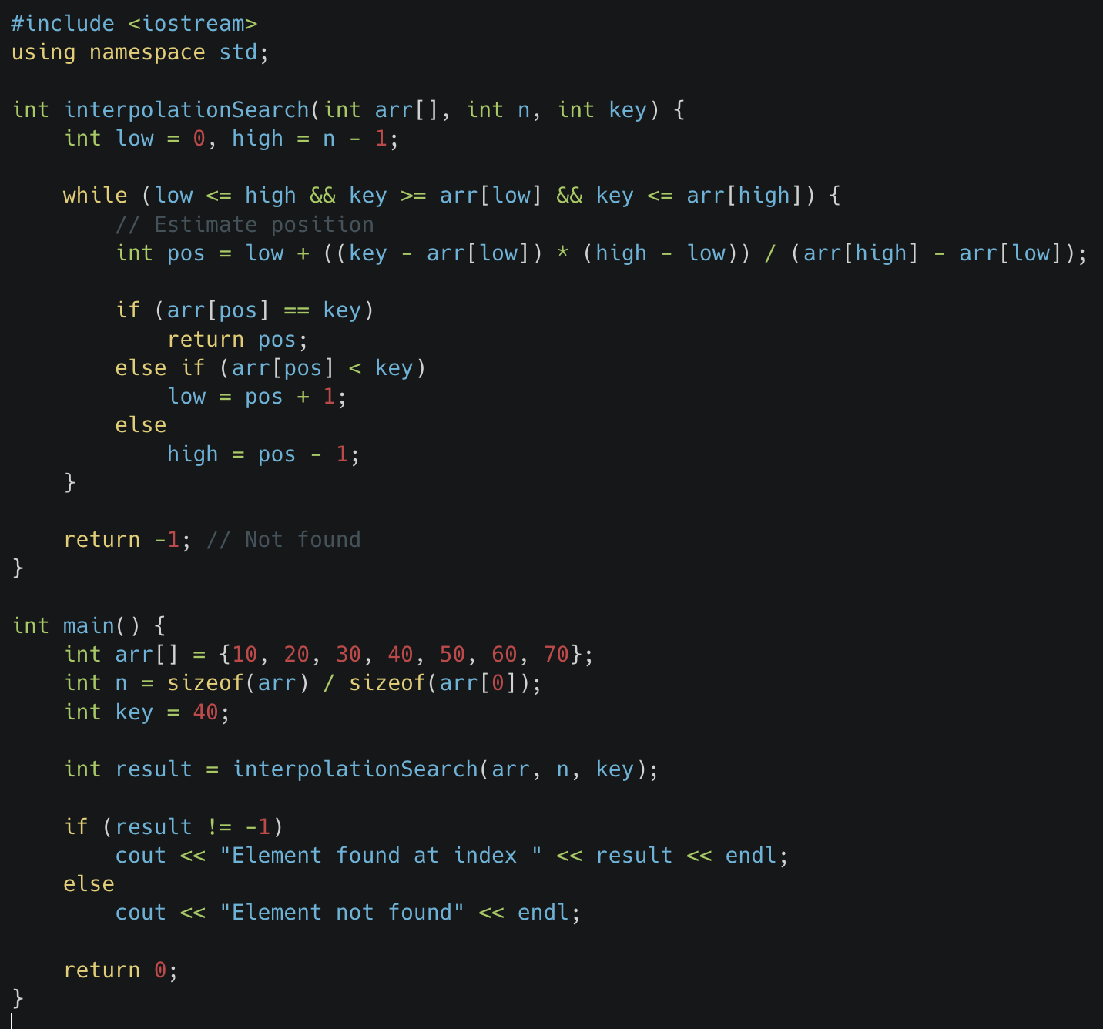
Interpolation Search Using C++

Slide 7
Interpolation Search Using C++

Slide 8
Thank You !

